Slide 1

Data Types, Variables & Type Casting
Presenter: Shubham Rawat

Slide 2

Session Objective:
To understand Java’s primitive and reference data types, variable declaration rules, type casting, and input handling using Scanner.

Slide 3

Topics Covered
Primitive types (byte, short, int, long, float, double, char, boolean)
Reference types
Memory allocation basics
Type casting (implicit & explicit)
Wrapper classes
Taking user input through Scanner

Slide 4
Data types

Slide 5
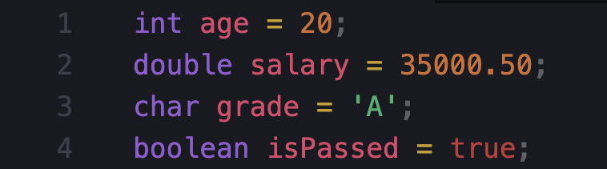
What is a Variable?
Variable = Named memory location used to store data
Rules for variable names
Must start with letter, _ or $
Cannot start with digit
No spaces (use camelCase)
Keywords not allowed (int, class, etc.)

Slide 6
Data Types in Java

Slide 7
Primitive Data Types (8 types)
byte (1 byte)
short (2 bytes)
int (4 bytes)
long (8 bytes)
float (4 bytes)
double (8 bytes)
char (2 bytes)
boolean (true/false)
Non-Primitive (Reference) Types
These store reference/address of objects.
String
Arrays
Classes / Objects
Interfaces

Slide 8
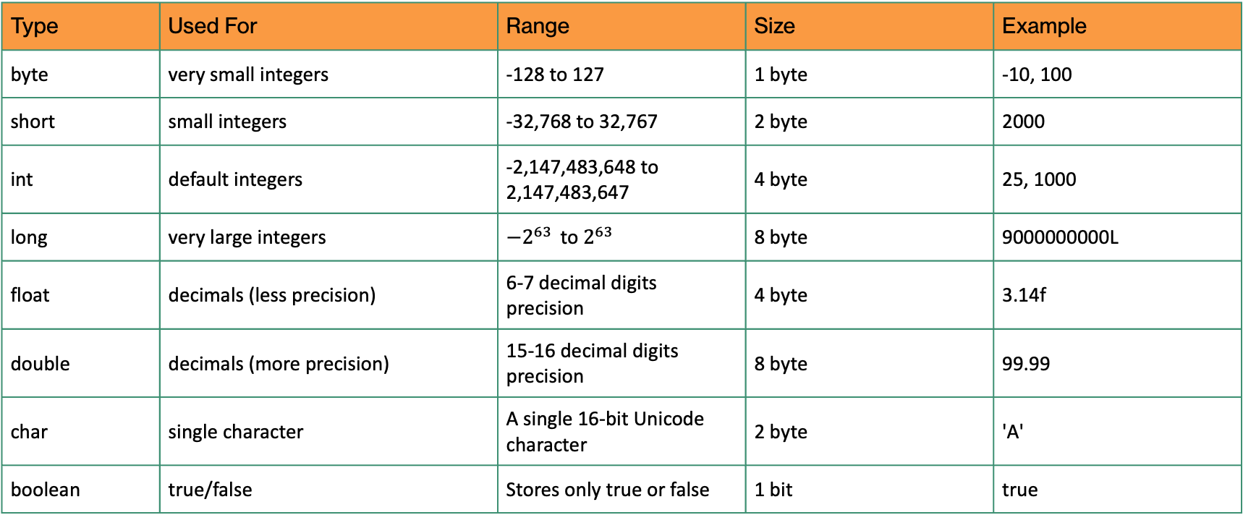
Primitive Types
Type | Used For | Range | Size | Example
byte | very small integers | -128 to 127 | 1 byte | -10, 100
short | small integers | -32,768 to 32,767 | 2 byte | 2000
int | default integers | -2,147,483,648 to 2,147,483,647 | 4 byte | 25, 1000
long | very large integers | $−2^{63 }$ to $2^{63}$ | 8 byte | 9000000000L
float | decimals (less precision) | 6-7 decimal digits precision | 4 byte | 3.14f
double | decimals (more precision) | 15-16 decimal digits precision | 8 byte | 99.99
char | single character | A single 16-bit Unicode character | 2 byte | 'A'
boolean | true/false | Stores only true or false | 1 bit | true

Slide 9
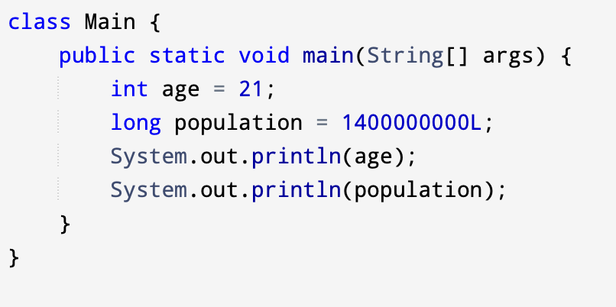
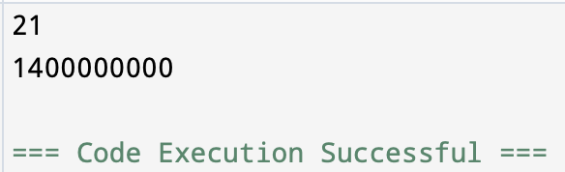
Integer
byte → small values (memory saving)
short → slightly bigger than byte
int → most commonly used for numbers
long → very large numbers (use L at end)

Slide 10
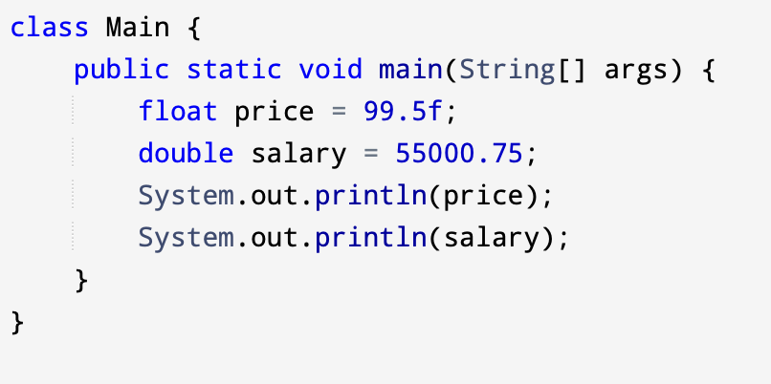
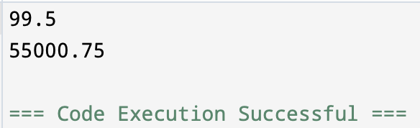
float vs double
float → decimal values, less precision
double → more precision, most commonly used
By default, Java treats decimals as double

Slide 11
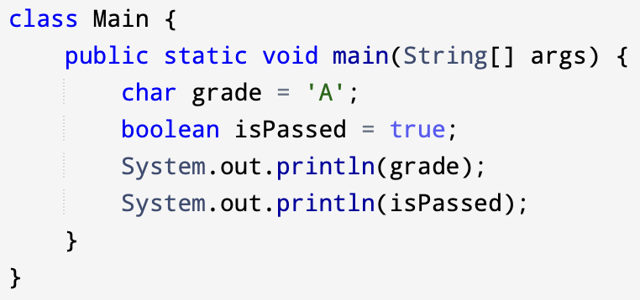
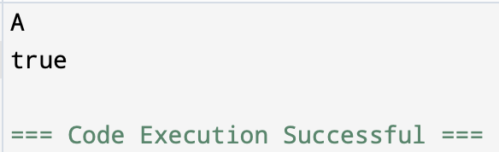
char and boolean
char
Stores a single character
Written inside single quotes ‘ ‘
boolean
Stores only true or false

Slide 12
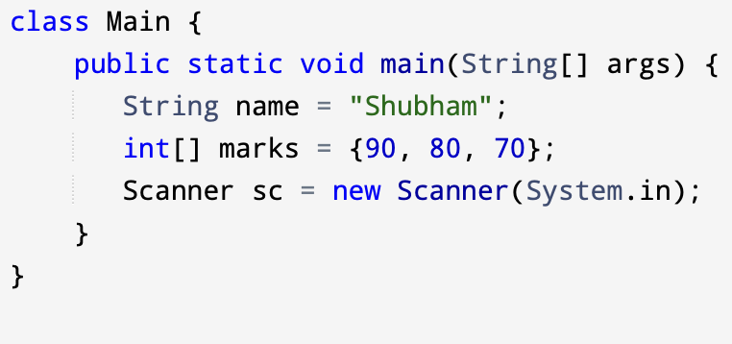
Reference Data Types
Reference types store the address (reference) of an object
Used when data is complex (text, collections, objects)

Slide 13
Memory Basics
Primitive | Reference
Stores value directly | Stores object address
Less memory | More memory
Faster | Slightly slower
Cannot be null | Can be null
No methods | Has methods
Primitive
Stores the actual value directly
Example: int x = 10;
Reference
Stores the address of the object
Example: String s = "Hi";
Simple view:
x → 10 (direct value)
s → address → "Hi" (object stored elsewhere)

Slide 14
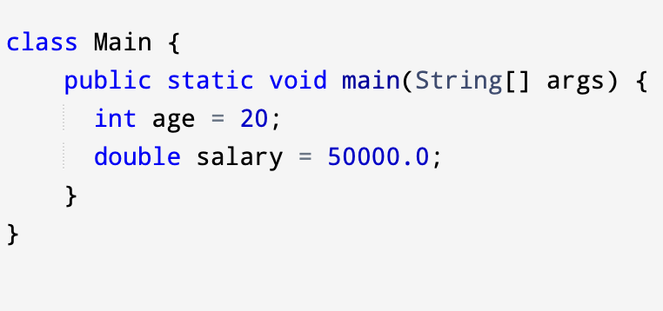
Variables in Java
A variable is a named memory location.
datatype variableName = value;

Slide 15
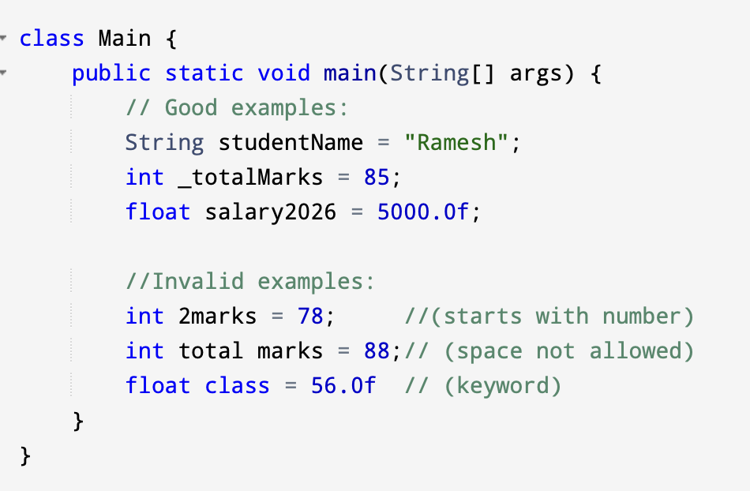
Variable Naming Rules
Valid:
Must start with letter, _, or $
Can include digits after first character
Case-sensitive (age and Age are different)

Slide 16
Type Casting
This is the process of converting one data type to another.
Implicit / Automatic (Widening): Automatically converting a smaller type to a larger type (e.g., int to double).
Explicit / Manual (Narrowing): Manually converting a larger type to a smaller type (e.g., double to int), which may result in data loss.

Slide 17
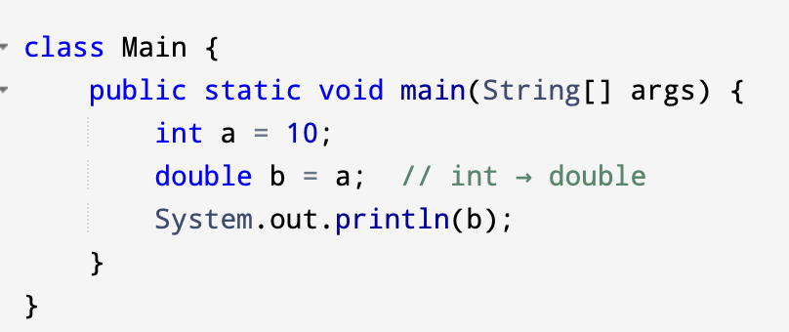
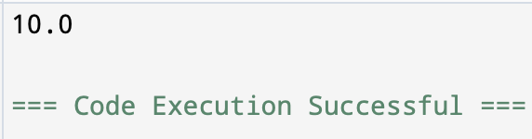
Widening Conversion (Automatic)
Converts smaller type → larger type
Happens automatically
No data loss

Slide 18
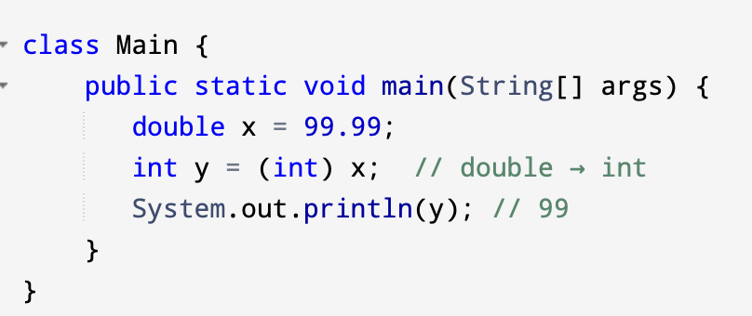
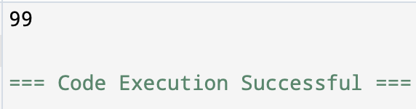
Narrowing Conversion (Manual)
Converts larger type → smaller type
Must use explicit cast
Data loss possible

Slide 19
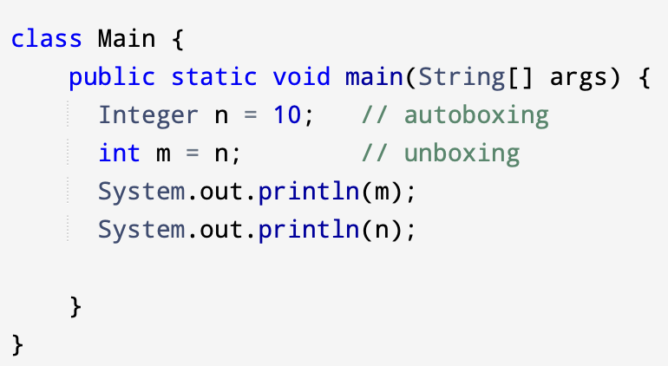
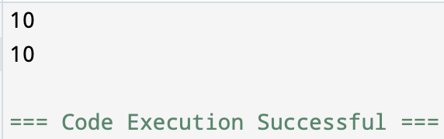
Wrapper Classes
Wrapper classes convert primitives into objects.
Examples:
int → Integer
double → Double
char → Character
boolean → Boolean

Slide 20
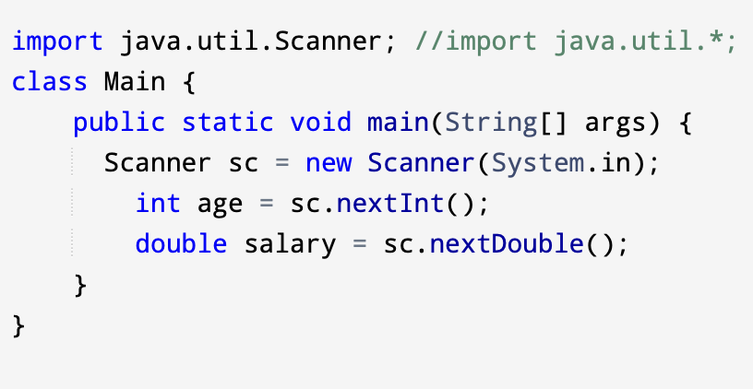
User Input with Scanner
Scanner is used to take input from keyboard.
nextInt() → int input
nextDouble() → double input
next() → single word string
nextLine() → full line string

